Slide 1
Week 1
The Basics

Slide 2
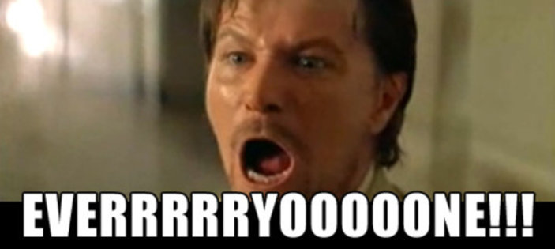
Who needs this information?

Slide 3
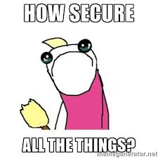
Why are we here?

Slide 4
Corporate vs Personal Security
The Basics
Corporate
  Company Security teams
  Larger target
  More weaknesses
Personal
  How to not get hacked (a.k.a don’t be pwned)

Slide 5
Activity!
https://haveibeenpwned.com/

Slide 6
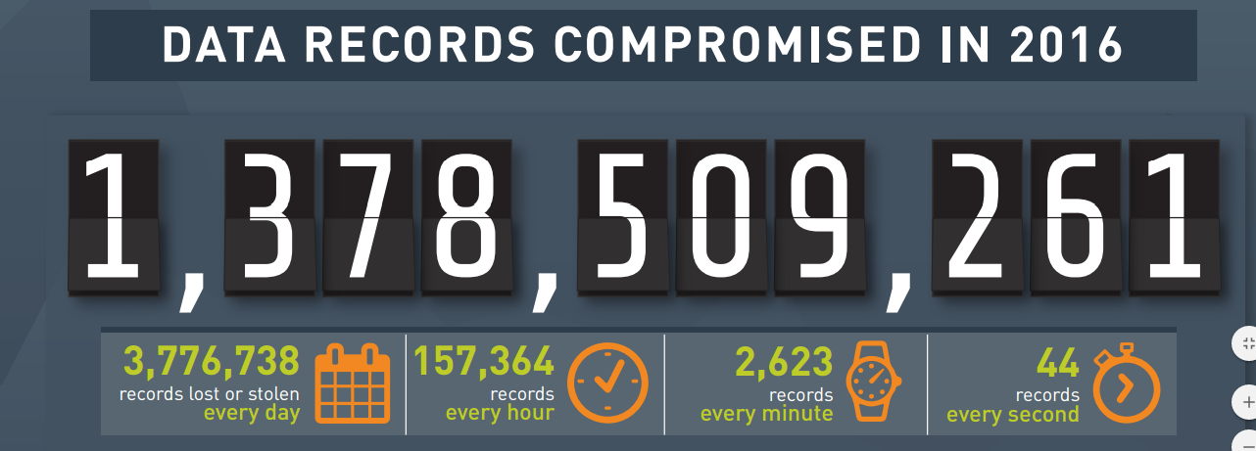
Am I alone in the pwnage?
http://www.informationisbeautiful.net/visualizations/worlds-biggest-data-breaches-hacks/
https://blog.gemalto.com/security/2017/03/29/2016-data-breach-trends-hackers-mine-large-databases-personal-gain/

Slide 7
But, Why did the Pwn happen?
Your password probably sucks
    Hey! It doesn’t suck, I use the same awesome password everywhere ← NO
    Hey! It doesn’t suck, QWERTY is sooo easy to remember ← NO
    Hey! My dog/mother/friends name is an awesome password ← NO
You don’t have/use two factor authentication
You tell the truth on the security questions when you register for sites

Slide 8
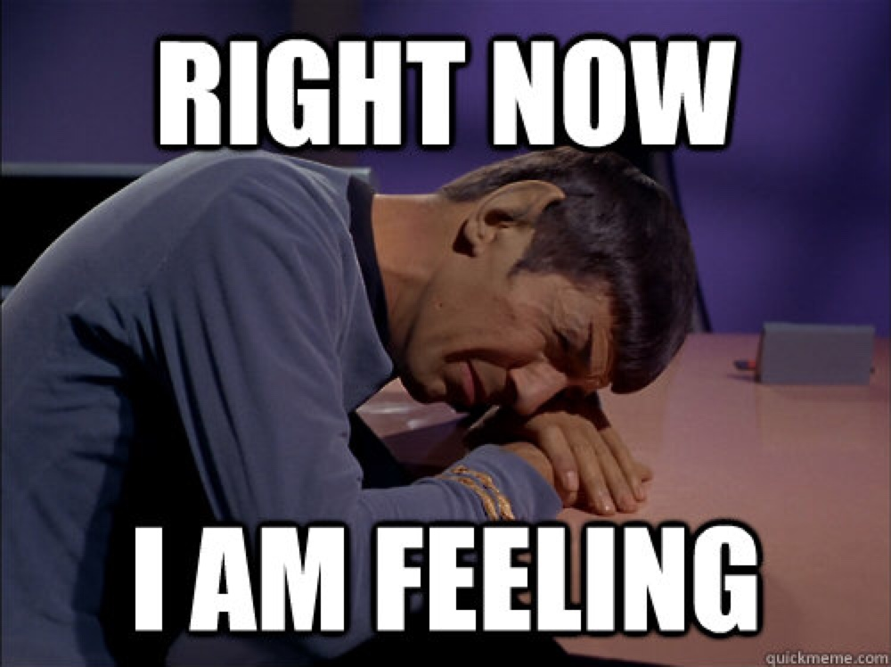
Am sad over pwnage, how fix?
https://krebsonsecurity.com/password-dos-and-donts/
https://www.wired.com/2016/05/password-tips-experts/
https://www.askideas.com/31-most-funny-sad-pictures-and-photos/

